Slide 1
With a estimated 29.95% reduction in Surjek’s Revenues ($141 M) due to the Maintenance Outage, Quarter Q4 presents the best balance of revenue-loss mitigation with respect to market pricing, as opposed to Quarter Q1 which represents the highest demand (2273 GL) and Water Balancing Market Prices (84.84).

Slide 2
Of the three Desalination Plants, all three remain profitable at current market prices by a favourable margin; Clearly Kootha is the most cost-effective $25/ML) followed by Jutik ($35.80/ML) and lastly Surjek ($54/ML) which is consistent across the July-2013 to June-2014 period.

Slide 3
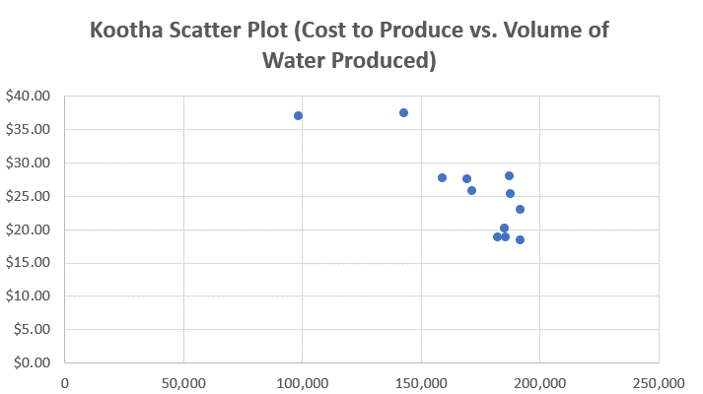
Contrasting the Cost to Produce against the Volume of Water Produced highlights clear economies of scale with costs rapidly dwindling across all plants as volume surges, with this being particularly noticeable across the Kootha and Surjek Plants with costs dropping as much as 50%.

Slide 4
It is apparent that regardless of the demand, the price does not seem to move (it is not very flexible). For the hard water product, the plot shows classic inelastic properties. On the other hand, for the soft water as well as soft and hard water, the average quantity of water has been largely affected by average price. For soft water and soft and hard water, the scatter plot shows elastic properties.

Slide 5
It is apparent that regardless of the demand, the price does not seem to move (it is not very flexible). For the hard water product, the plot shows classic inelastic properties. On the other hand, for the soft water as well as soft and hard water, the average quantity of water has been largely affected by average price. For soft water and soft and hard water, the scatter plot shows elastic properties.

